Slide 1
Cotton Analysis Assignment
EPABA 2017
Group – Saurabh Bhatia
Jaskeerat Singh
Garima Kaushik

Slide 2
Background
National Cotton Fabric Association Board has observed a decline in domestic cotton sales and product and wants to:
Understand and estimate the impact of whole sale price and imports on cotton sales and production
Leverage the demand model to determine the price that will maximize the total revenue
Methodology
The group performed the analysis over the available data to:
Perform the trend analysis of cotton production, price, imports and exports to identify patterns in the data
Build the statistical model estimating the relationship of production with price, imports, exports, and determining the price that will maximize the revenue
Results
The decline in cotton sales and production is primarily driven by increase in the whole sale price of the cotton. The import of cotton marginally impacts the cotton sales and production. In order to increase the revenue from cotton sales, the whole sale price of cotton should be reduced to a level of $ 98 /lb at which the total quarterly revenue will hit a maximum of $ 213,395

Slide 3
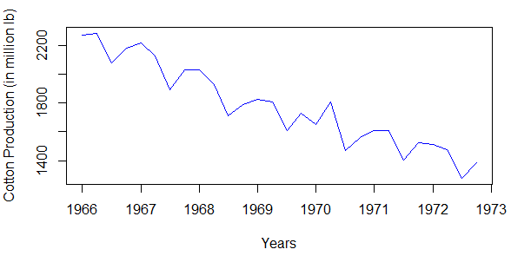
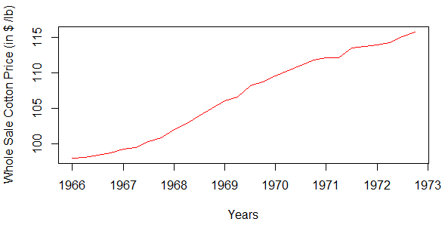
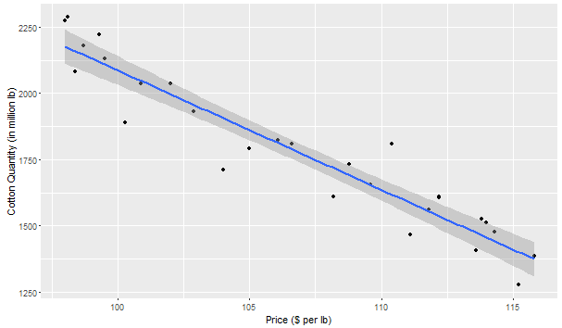
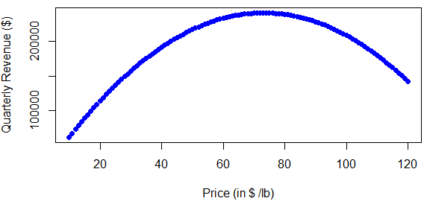
Analysis Results
Cotton production follows linearly decreasing trend with seasonality
Wholesale cotton price follows linearly increasing trend without seasonality
Prod = 6599.84 – 45.126*price
Maximum in data range
R² = 0.9022 and p < 0.05
Global Maximum
$73/lb
$98/lb
Cotton production and price holds linearly decreasing relationship
Total Revenue increases till the price of $73/lb and decreases thereafter
Import and Exports don’t impact the cotton production markedly
A unit increase in imports will lead to decrease in production by 6.5175 units
A unit increase in exports will lead to increase in production by 0.3190 units
A balanced trade of a unit will lead to decrease in production by 6.1985 units
Prod = 6757.0093 - 46.9564*price - 6.5175*import + 0.3190*export
R² = 0.9347 and p < 0.05

